Slide 1
Introduction to Cryptography
CONFIDENTIALITY - SYMMETRIC KEY CRYPTO SYSTEMS

Slide 2
CONFIDENTIALITY - SYMMETRIC KEY CRYPTO SYSTEMS
Terminologies
A message is plaintext (sometimes called cleartext).
The process of disguising a message in such a way as to hide its substance is encryption.
An encrypted message is ciphertext. The process of turning ciphertext back into plaintext is decryption.
A cipher (or cypher) is an algorithm for performing encryption or decryption—a series of well-defined steps that can be followed as a procedure.
A cryptosystem is an implementation of cryptographic techniques and their accompanying infrastructure to provide information security services.
A cryptosystem is also referred to as a cipher system.

Slide 3
CONFIDENTIALITY - SYMMETRIC KEY CRYPTO SYSTEMS
Terminologies Cont….
While cryptography is the science of securing data, cryptanalysis is the science of analyzing and breaking secure communication.
Cryptology embraces both cryptography and cryptanalysis.
Cryptography is thus the science of using mathematics to encrypt and decrypt data.
Cryptography is the art and science of keeping messages secure.
Symmetric cryptography, known also as secret key cryptography, is the use of a single shared secret to share encrypted data between parties.
Ciphers in this category are called symmetric because you use the same key to encrypt and to decrypt the data.
Encipher (encode) The process of converting plaintext to cipher text using a cipher and a key

Slide 4
CONFIDENTIALITY - SYMMETRIC KEY CRYPTO SYSTEMS
Decipher (decode) the process of converting cipher text back into plaintext using a cipher and a key
Cryptographic techniques allow a sender to disguise data so that an intruder can gain no information from the intercepted data.
Security of computer networks and systems is almost always discussed within information security that has three fundamental objectives,
  namely confidentiality, integrity, and availability.
CONFIDENTIALITY
Confidentiality means that data, objects and resources are protected from unauthorized viewing and other access.
Confidentiality assures that private or confidential information is not made available or disclosed to unauthorized individuals
  A loss of confidentiality results in unauthorized disclosure of information.

Slide 5
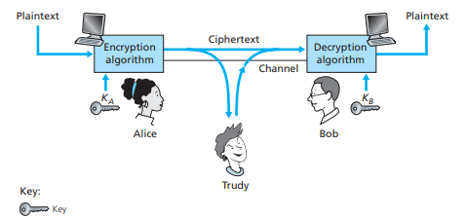
CONFIDENTIALITY - SYMMETRIC KEY CRYPTO SYSTEMS
Encryption is a commonly used tool to achieve confidentiality.
Cryptographic techniques allow a sender to disguise data so that an intruder can gain no information from the intercepted data.
The receiver must be able to recover the original data from the disguised data. Below is the summary of Cryptographic terminologies.

Slide 6
CONFIDENTIALITY - SYMMETRIC KEY CRYPTO SYSTEMS
Suppose now that Alice wants to send a message to Bob.
Alice encrypts her plaintext message using an encryption algorithm so that the encrypted message looks unintelligible to any intruder.
In many modern cryptographic systems, including those used in the Internet, the encryption technique itself is known—published, standardized,
  and available to everyone (for example, [RFC 1321; RFC 3447; RFC 2420; NIST 2001]), even a potential intruder!
If everyone knows the method for encoding data, then there must be some secret information that prevents an intruder from decrypting the transmitted data.
This is known as the key.
Alice provides a key, KA, a string of numbers or characters, as input to the encryption algorithm.

Slide 7
CONFIDENTIALITY - SYMMETRIC KEY CRYPTO SYSTEMS
The encryption algorithm takes the key and the plaintext message, m, as input and produces ciphertext as output.
The notation KA(m) refers to the ciphertext form (encrypted using the key KA) of the plaintext message, m.
If Bob receives an encrypted message KA(m), he decrypts it by computing KB(KA(m)) = m.
In symmetric key systems, Alice’s and Bob’s keys are identical and are secret.
In public key systems, a pair of keys is used. One of the keys is known to both Bob and Alice
The other key is known only by either Bob or Alice (but not both).

Slide 8
CONFIDENTIALITY - SYMMETRIC KEY CRYPTO SYSTEMS
Symmetric Key Cryptography
Stream Ciphers
All cryptographic algorithms involve substituting one thing for another,
for example, taking a piece of plaintext and then computing and substituting the appropriate ciphertext to create the encrypted message.
Caesar cipher: The Caesar cipher works by taking each letter in the plaintext message and substituting the letter that is k letters later (allowing wraparound;
that is, having the letter z followed by the letter a) in the alphabet.
For example if k = 3, then the letter a in plaintext becomes d in ciphertext;
b in plaintext becomes e in ciphertext, and so on. Here, the value of k serves as the key.
The Caesar cipher is an example of a stream cipher; that is, it encodes one character at a time.

Slide 9

CONFIDENTIALITY - SYMMETRIC KEY CRYPTO SYSTEMS
While the ciphertext does indeed look like gibberish, it wouldn’t take long to break the code if you knew that the Caesar cipher was being used,
  as there are only 25 possible key values
An improvement on the Caesar cipher is the monoalphabetic cipher, which also substitutes one letter of the alphabet with another letter of the alphabet.
However, rather than substituting according to a regular pattern (for example, substitution with an offset of k for all letters),
any letter can be substituted for any other letter, as long as each letter has a unique substitute letter, and vice versa.
The substitution rule in the figure below shows one possible rule for encoding plaintext.

Slide 10
CONFIDENTIALITY - SYMMETRIC KEY CRYPTO SYSTEMS
A monoalphabetic cipher would also appear to be better than the Caesar cipher in that there are 26!
  (on the order of 10^26) possible pairings of letters rather than 25 possible pairings.
A brute-force approach of trying all 10^26 possible pairings would require far too much work to be a feasible way of breaking the encryption algorithm and decoding the message.
However, if the intruder has some knowledge about the possible contents of the message, then it is even easier to break the code.
by statistical analysis of the plaintext language and knowing that particular two-and three-letter occurrences of letters appear quite often together,
  it is relatively easy to break the code.
Five hundred years ago, techniques improving on monoalphabetic encryption, known as polyalphabetic encryption, were invented..

Slide 11

CONFIDENTIALITY - SYMMETRIC KEY CRYPTO SYSTEMS
The idea behind polyalphabetic encryption is to use multiple monoalphabetic ciphers,
  with a specific monoalphabetic cipher to encode a letter in a specific position in the plaintext message.
Thus, the same letter, appearing in different positions in the plaintext message, might be encoded differently.
A polyalphabetic cipher using two Caesar ciphers is shown below.
Using C1,C2,C2,C1,C2 encrypt the message “Cyber security is cool”

Slide 12

CONFIDENTIALITY - SYMMETRIC KEY CRYPTO SYSTEMS
An example of a polyalphabetic encryption scheme shown has two Caesar ciphers (with k = 5 and k = 19), shown as rows.
We might choose to use these two Caesar ciphers, C1 and C2 , in the repeating pattern C1 , C2 , C2 , C1 , C2 .
That is, the first letter of plaintext is to be encoded using C1 , the second and third using C2 , the fourth using C1 , and the fifth using C2 .
The pattern then repeats, with the sixth letter being encoded using C1 , the seventh with C2 , and so on.
We can replace the simple shift mechanism of the Caesar cipher with a more complex substitution mechanism, for example:

Slide 13
CONFIDENTIALITY - SYMMETRIC KEY CRYPTO SYSTEMS
Class Open Book Quiz
Time: 10 Minutes
1. Using a Caesar cipher with s = 5, encrypt the message NOW IS THE HOUR.
2. A messenger tells you that the secret key for today for the Caesar cipher is s = 26. Should you trust the messenger? Why, or why not?

Slide 14
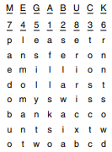
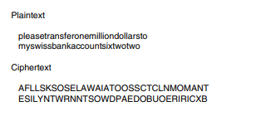
CONFIDENTIALITY - SYMMETRIC KEY CRYPTO SYSTEMS
Transposition Ciphers
Substitution ciphers preserve the order of the plaintext symbols but disguise them. Transposition ciphers, in contrast, reorder the letters but do not disguise them.
Figure below depicts a common transposition cipher, the columnar transposition. The cipher is keyed by a word or phrase not containing any repeated letters.
In this example, MEGABUCK is the key.

Slide 15
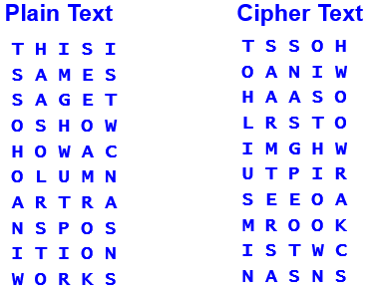
CONFIDENTIALITY - SYMMETRIC KEY CRYPTO SYSTEMS
The purpose of the key is to order the columns, with column 1 being under the key letter closest to the start of the alphabet, and so on.
The plaintext is written horizontally, in rows, padded to fill the matrix if need be.
The ciphertext is read out by columns, starting with the column whose key letter is the lowest.
Class exercise: If ADREA is the Key, use columnar transposition to decrypt the message SEAZITFQIMRITIOU

Slide 16
CONFIDENTIALITY - SYMMETRIC KEY CRYPTO SYSTEMS
Block cipher. In a block cipher, a group or block of plaintext letters gets encoded into a block of ciphertext
  but not by substituting one character at a time for each letter
Each plaintext character in the block contributes to more than one ciphertext character
  and each ciphertext character is the result of more than one plaintext letter
It is as if each plaintext character in a block gets chopped into little pieces,
  and these pieces are scattered among the ciphertext characters in the corresponding block.
This tends to destroy the structure of the plaintext and make decryption more difficult.

Slide 17


CONFIDENTIALITY - SYMMETRIC KEY CRYPTO SYSTEMS
As a simple example, we’ll use a block size of 2 and an encoding key that is a 2 X 2 arrangement of numbers called a matrix. Here A and B,
To obtain the element in row 1, column 2 of the result, we multiply the row 1 elements of A by the corresponding column 2 elements of B and add the results:

Slide 18
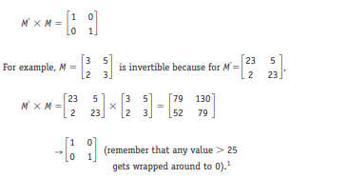
CONFIDENTIALITY - SYMMETRIC KEY CRYPTO SYSTEMS
However, for encryption purposes, we are going to modify this definition.
When we add up the terms for each element, whenever we exceed 25,
  we will start over again, counting from 0. In this scheme, 26 → 0, 27 → 1, 28 → 2, . . . 52→ 0, and so on
Not every 2 X 2 matrix can serve as an encryption key; we need an invertible matrix. This is a matrix M for which there is another matrix M’ such that

Slide 19

CONFIDENTIALITY - SYMMETRIC KEY CRYPTO SYSTEMS
This property is what allows M’ to reverse the effect of M.
Also, part of our encryption algorithm is a simple substitution S that maps letters into numbers;
  we’ll let S be really simple here: S(A) = 1, S(B) = 2, . . . , S(Z) = 26.
Obviously S is reversible, and we’ll call the reverse mapping S’: S’(1) = A, S’(2) = B, . . . , S’(26) = Z.
To encode our message, we break it up into two-character blocks. Suppose the first two characters form the block (D E).
We apply the S mapping to this block to get (4 5). Now we multiply (4 5) X M by treating (4 5) as the row of some matrix
  and then we wrap around if the result exceeds 25.

Slide 20
CONFIDENTIALITY - SYMMETRIC KEY CRYPTO SYSTEMS
Finally, apply the S’ mapping to get from digits back to characters: S’ (22 9) = (V I).
This completes the encoding, and (V I) is the ciphertext for the message block (D E).
Notice that the digit 4 (i.e., the plaintext letter D) contributed to both the 22 (V) and the 9 (I), as did the digit 5 (i.e., the plaintext letter E).
This diffusion (scattering) of the plaintext within the ciphertext is the advantage of a block cipher.
For decoding, we reverse the above steps. Starting with the ciphertext (V I), we first apply S to get (22 9).
We then multiply (22 9) by M’, the inverse of the encoding key (remembering to wrap around if the result exceeds 25):

Slide 21

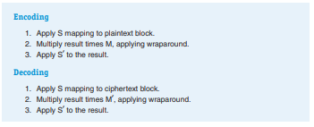
CONFIDENTIALITY - SYMMETRIC KEY CRYPTO SYSTEMS
Finally we apply S’ to get back the plaintext (D E).
The steps of encoding and decoding for a block cipher are summarized below. Again, the matrix M is the secret encryption key, from which the decryption key M’ can be derived.

Slide 22
CONFIDENTIALITY - SYMMETRIC KEY CRYPTO SYSTEMS
Let us now move forward to modern times and examine how block cipher symmetric key encryption is done today
In a block cipher, the message to be encrypted is processed in blocks of k bits. For example,
if k = 64, then the message is broken into 64-bit blocks, and each block is encrypted independently.
To encode a block, the cipher uses a one-to-one mapping to map the k-bit block of cleartext to a k-bit block of ciphertext.
Suppose that k = 3, so that the block cipher maps 3-bit inputs (cleartext) to 3-bit outputs (ciphertext).
Notice that this is a one-to-one mapping; that is, there is a different output for each input.

Slide 23
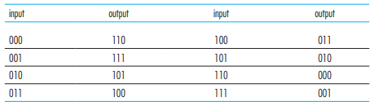
CONFIDENTIALITY - SYMMETRIC KEY CRYPTO SYSTEMS
One possible mapping is given in table below.
This block cipher breaks the message up into 3-bit blocks and encrypts each block according to the above mapping.
note that the mapping in the table above is just one mapping of many possible mappings.

Slide 24
CONFIDENTIALITY - SYMMETRIC KEY CRYPTO SYSTEMS
observe that a mapping is nothing more than a permutation of all the possible inputs.
There are 2^ 3 (= 8) possible inputs (listed under the input columns). These eight inputs can be permuted in 8! = 40,320 different ways.
Since each of these permutations specifies a mapping, there are 40,320 possible mappings between input and output.
The brute-force attack for this cipher is to try to decrypt ciphtertext by using all mappings.
With only 40,320 mappings (when k = 3), this can quickly be accomplished on a desktop PC.
To thwart brute-force attacks, block ciphers typically use much larger blocks, consisting of k = 64 bits or even larger.

Slide 25
CONFIDENTIALITY - SYMMETRIC KEY CRYPTO SYSTEMS
Note that the number of possible mappings for a general k-block cipher is 2^k !, which is astronomical for even moderate values of k (such as k = 64).
Although full-table block ciphers, with moderate values of k can produce robust symmetric key encryption schemes.
  they are unfortunately difficult to implement.
For k = 64 and for a given mapping, Alice and Bob would need to maintain a table with 2^64 input values, which is an infeasible task.
Instead, block ciphers typically use functions that simulate randomly permuted tables.
An example of such a function for k = 64 bits is shown in on the next slide.
The function first breaks a 64-bit block into 8 chunks, with each chunk consisting of 8 bits.

Slide 26
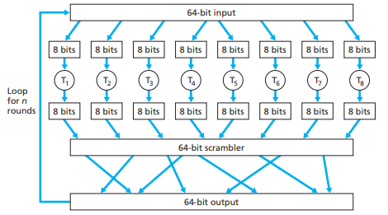
CONFIDENTIALITY - SYMMETRIC KEY CRYPTO SYSTEMS
Each 8-bit chunk is processed by an 8-bit to 8-bit table, which is of manageable size. For example, the first chunk is processed by the table denoted by T1 .

Slide 27
CONFIDENTIALITY - SYMMETRIC KEY CRYPTO SYSTEMS
Next, the 8 output chunks are reassembled into a 64-bit block.
The positions of the 64 bits in the block are then scrambled (permuted) to produce a 64-bit output.
This output is fed back to the 64-bit input, where another cycle begins.
After n such cycles, the function provides a 64-bit block of ciphertext
Today there are a number of popular block ciphers,
  including Data Encryption Standard(DES), Triple DES (3DES), and Advanced Encryption Standard(AES).
Each of these standards uses functions, rather than predetermined tables.
DES uses 64-bit blocks with a 56-bit key. AES uses 128-bit blocks and can operate with keys that are 128, 192, and 256 bits long.

Slide 28
CONFIDENTIALITY - SYMMETRIC KEY CRYPTO SYSTEMS
DES
DES is a block cipher, and the blocks are 64 bits long, meaning that 64 plaintext bits at a time are processed into 64 ciphertext bits.
The key is a 64-bit binary key, although only 56 bits are actually used.
DES is an encryption algorithm developed by IBM in the 1970s for the U.S.
DES algorithm actually uses very simple operations—however, it uses them over and over
DES was designed to protect electronic information, so the plaintext is a binary string of 0s and 1s, just as it is stored in a computer.
this means that ordinary text has already undergone an encoding using ASCII or Unicode to convert characters to bit strings.

Slide 29
CONFIDENTIALITY - SYMMETRIC KEY CRYPTO SYSTEMS
The algorithm begins by sending the plaintext 64-bit string through an initial permutation (rearrangement).
The algorithm then cycles through 16 “rounds.” Each round i performs the following steps:
1. The incoming 64-bit block is split into a left half Li and a right half Ri .
  The right half Ri gets passed through unchanged to become the left half of the next round, Li+1.
2. In addition, the 32 bits in the right half get permuted according to a fixed formula and then expanded to 48 bits by duplicating some of the bits.
3. Meanwhile, the 56-bit key is also permuted (the result is passed on as the key to the next round) and then reduced to 48 bits by omitting some of the bits.
These two 48-bit strings are matched bit by bit, using an XOR (exclusive OR) gate for each bit

Slide 30
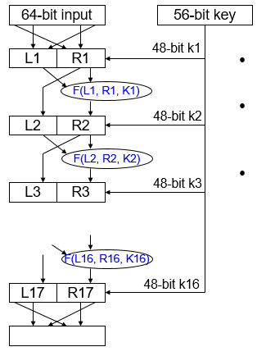
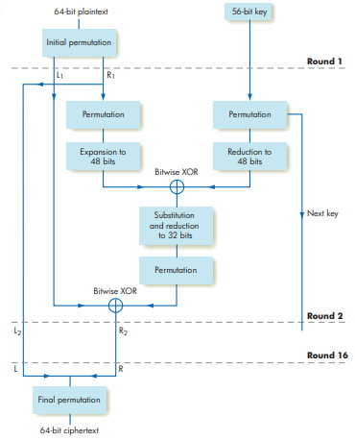
CONFIDENTIALITY - SYMMETRIC KEY CRYPTO SYSTEMS

Slide 31
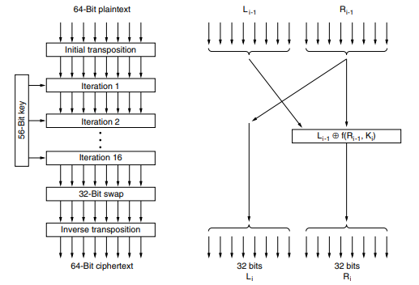
CONFIDENTIALITY - SYMMETRIC KEY CRYPTO SYSTEMS
The Data Encryption Standard. (a) General outline. (b) Detail of one iteration. The circled + means exclusive OR

Slide 32
CONFIDENTIALITY - SYMMETRIC KEY CRYPTO SYSTEMS
An outline of DES is shown on the previous slide. Plaintext is encrypted in blocks of 64 bits, yielding 64 bits of ciphertext.
The algorithm, which is parameterized by a 56-bit key, has 16 distinct stages. The first stage is a key-independent transposition on the 64-bit plaintext.
The last stage is the exact inverse of this transposition. The stage prior to the last one exchanges the leftmost 32 bits with the rightmost 32 bits.
The remaining 16 stages are functionally identical but are parameterized by different functions of the key.
The algorithm has been designed to allow decryption to be done with the same key as encryption, a property needed in any symmetric-key algorithm.
The steps are just run in the reverse order

Slide 33
CONFIDENTIALITY - SYMMETRIC KEY CRYPTO SYSTEMS
4. The resulting 48-bit string undergoes a substitution and reduction to emerge as a 32-bit string.
This string is permuted one more time, and the resulting 32-bit string is matched bit by bit, using XOR gates, with the left half Li of the input.
The result is passed to the next round as the new right half Ri+1
After all 16 rounds are complete, the final left and right halves are recombined into a 64-bit string that is permuted one more time,
  and the resulting 64-bit string is the ciphertext.
Triple DES improves the security of DES; it requires two 56-bit keys (which can be thought of as a 112-bit key length), and runs the DES algorithm three times:
Encode using key 1, decode the result using key 2, encode the result using key 1 again.

Slide 34
CONFIDENTIALITY - SYMMETRIC KEY CRYPTO SYSTEMS
Concerns about the eventual breakdown of DES in the face of ever-increasing computing power prompted introduction of AES
AES Advanced Encryption Standard is based on the Rijndael (pronounced Rin-dahl algorithm.
Like DES, AES uses successive rounds of computations that mix up the data and the key.
The key length can be 128, 192, or even 256 bits, and the algorithm appears to be very efficient.
From a mathematical perspective, Rijndael is based on Galois field theory, which gives it some provable security properties.
However, it can also be viewed as C code, without getting into the mathematics.
Like DES, Rijndael uses substitution and permutations, and it also uses multiple rounds.

Slide 35
CONFIDENTIALITY - SYMMETRIC KEY CRYPTO SYSTEMS
THE END OF LECTURE 2

